Slide 1


Slide 2

Digital Marketing
Assignment Report
ASSIGNMENT FOLIO
Assignment Folio of
Digital Marketing
Submitted to
Dezyne École College
Toward Digital Marketing
Rohit Panwar
BCA
Sem III
Dezyne École College
106/10, Civil Lines, Ajmer
www.dezyneecole.com

Slide 3
Digital Marketing
Acknowlegement
ASSIGNMENT FOLIO
We take this opportunity to express our sincere gratitude to Dezyne École College for providing us with the knowledge, resources, and guidance essential to the successful completion of this project.
Our deepest thanks to our respected Principal, Dr. Vinita Mathur, for her visionary leadership and continuous encouragement. Her commitment to academic excellence and student growth has been a constant source of motivation and pride.
We are equally thankful to all our faculty members for their consistent support, expert advice, and valuable insights that shaped our learning and helped us achieve this milestone.
Lastly, we extend heartfelt thanks to everyone who directly or indirectly contributed to the success of this project.
We are proud to be part of Dezyne École College, an institution that truly nurtures professionalism, innovation, and purpose.
With sincere appreciation,
Rohit Panwar
Department of Bachelor of Computer Applications
Dezyne École College, Ajmer

Slide 4
Digital Marketing
Case Study
ASSIGNMENT FOLIO
Objective :
Increase Website Traffic, Generate Quality Leads, Improve Brand Visibility, Boost Course Enrollments & Maximise ROI
Key Feature :
1. Search Campaign Strategy
Targeted high-intent keywords related to computer courses.
2. Structure Ad Groups
Separate ad groups for each course to improve relevant and Quality Score.
3. Optimized Wix Landing Page
Mobile-friendly design with strong call-to-action buttons.
4. Conversion Tracking Setup
Measure form submission and call clicks for performance analysis.
5. Smart Bidding Strategy
Used “Maximize Conversations” to optimize ad spend automatically

Slide 5
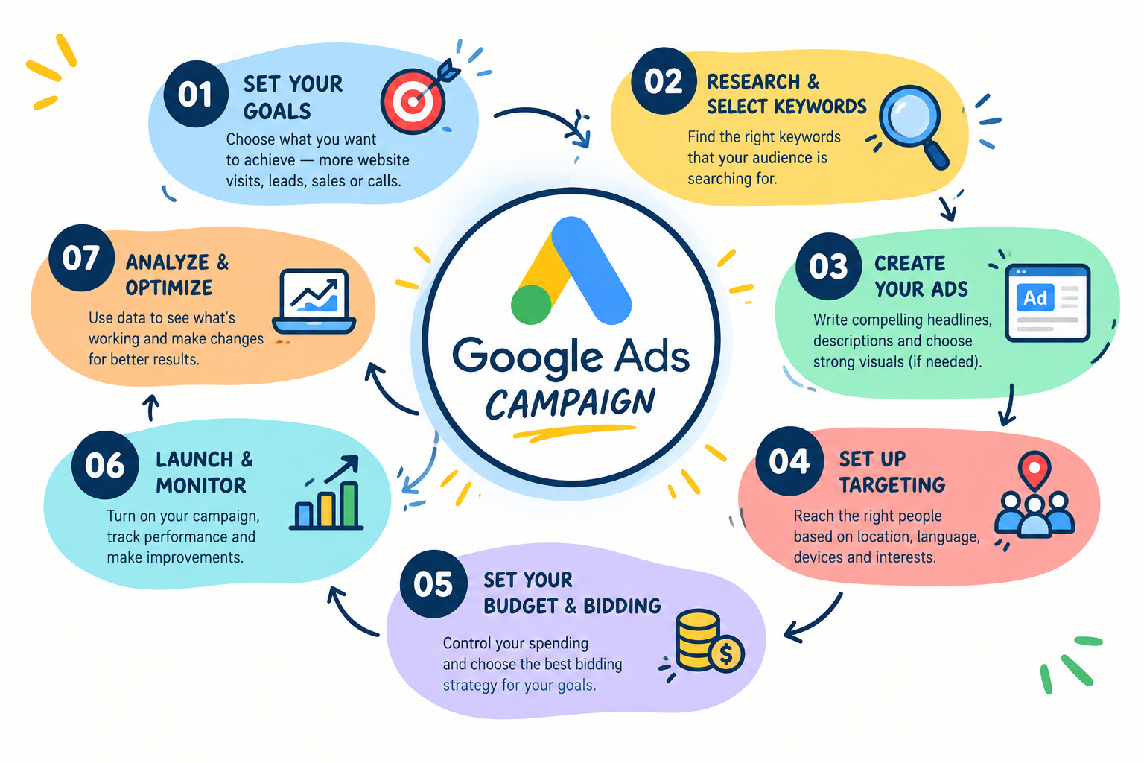

Slide 6

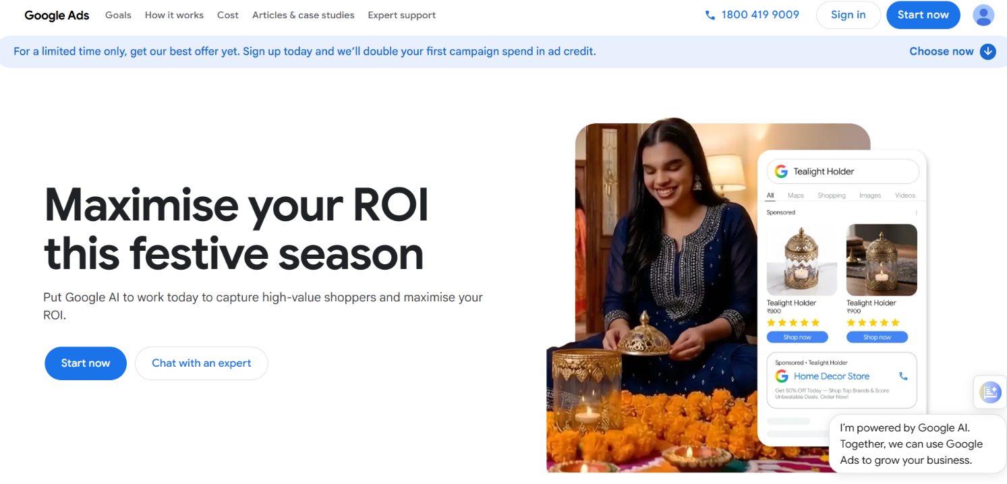
Google Ads - Overview

Slide 7
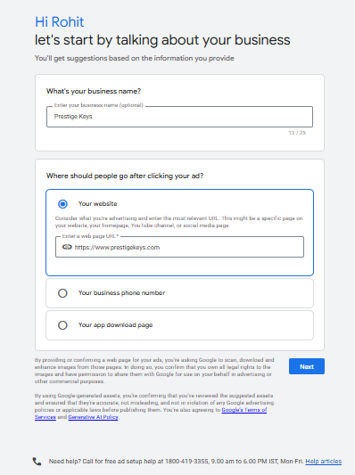
Google Ads – Account Setup

Slide 8
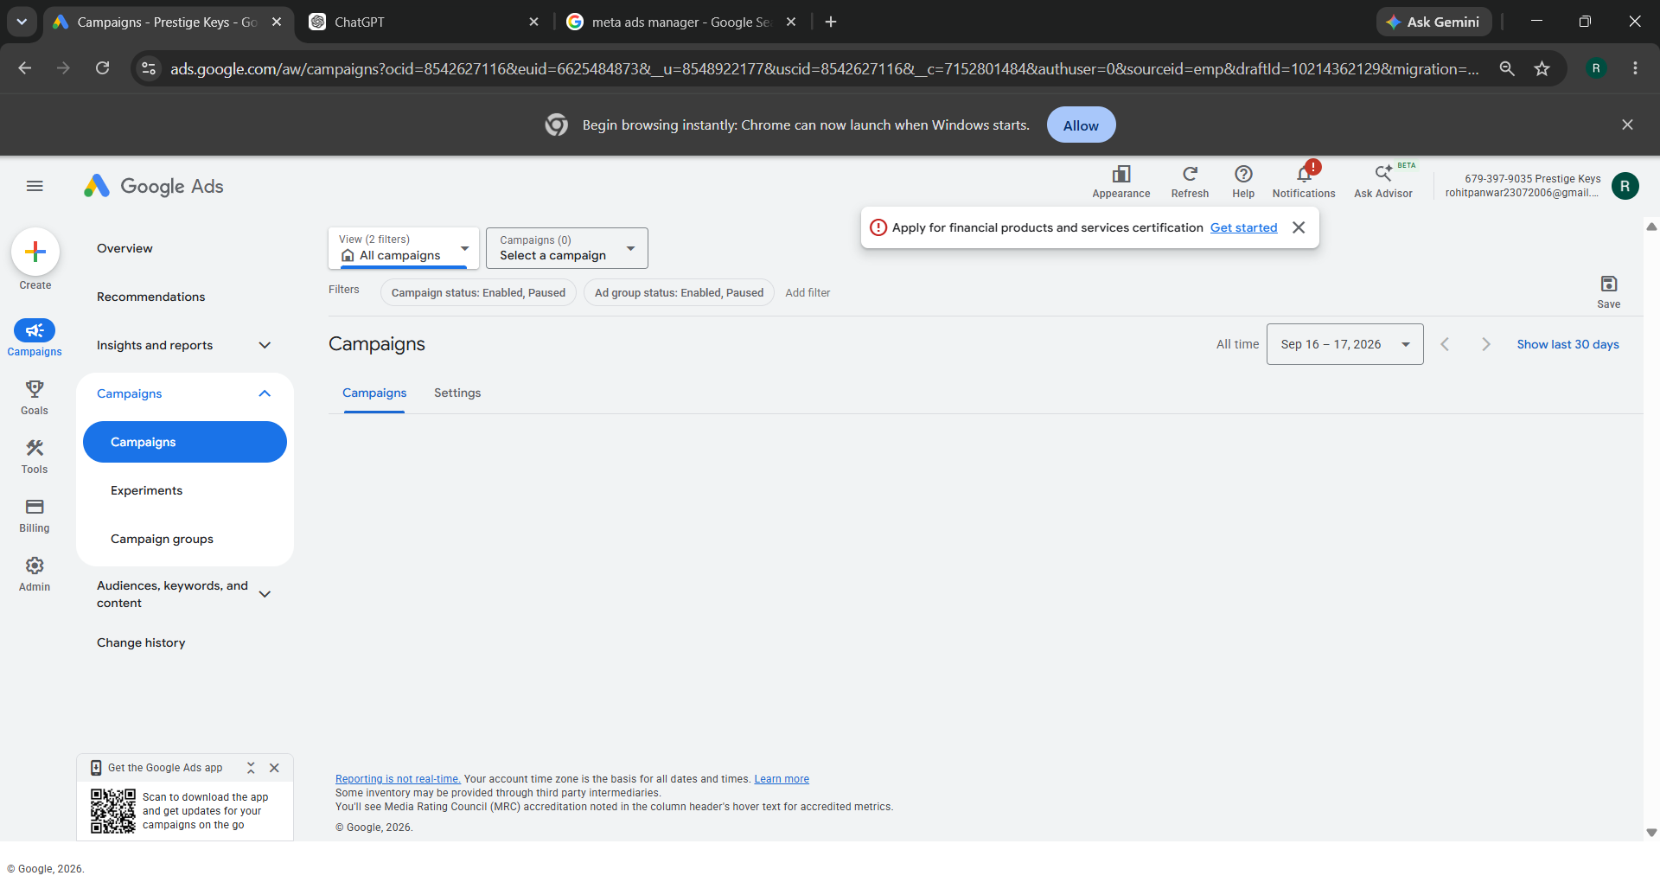
Google Ads - Dashboard

Slide 9
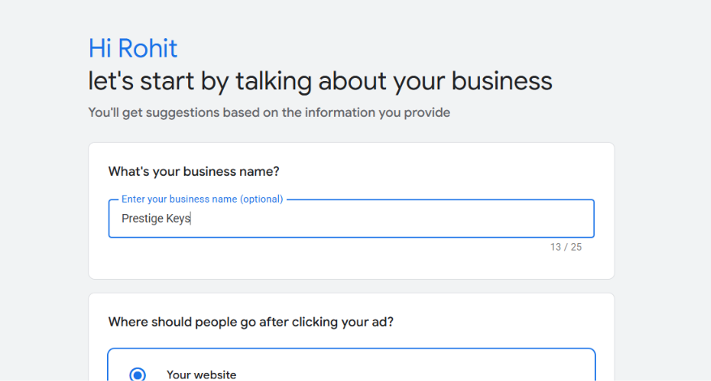
Campaign Setup

Slide 10
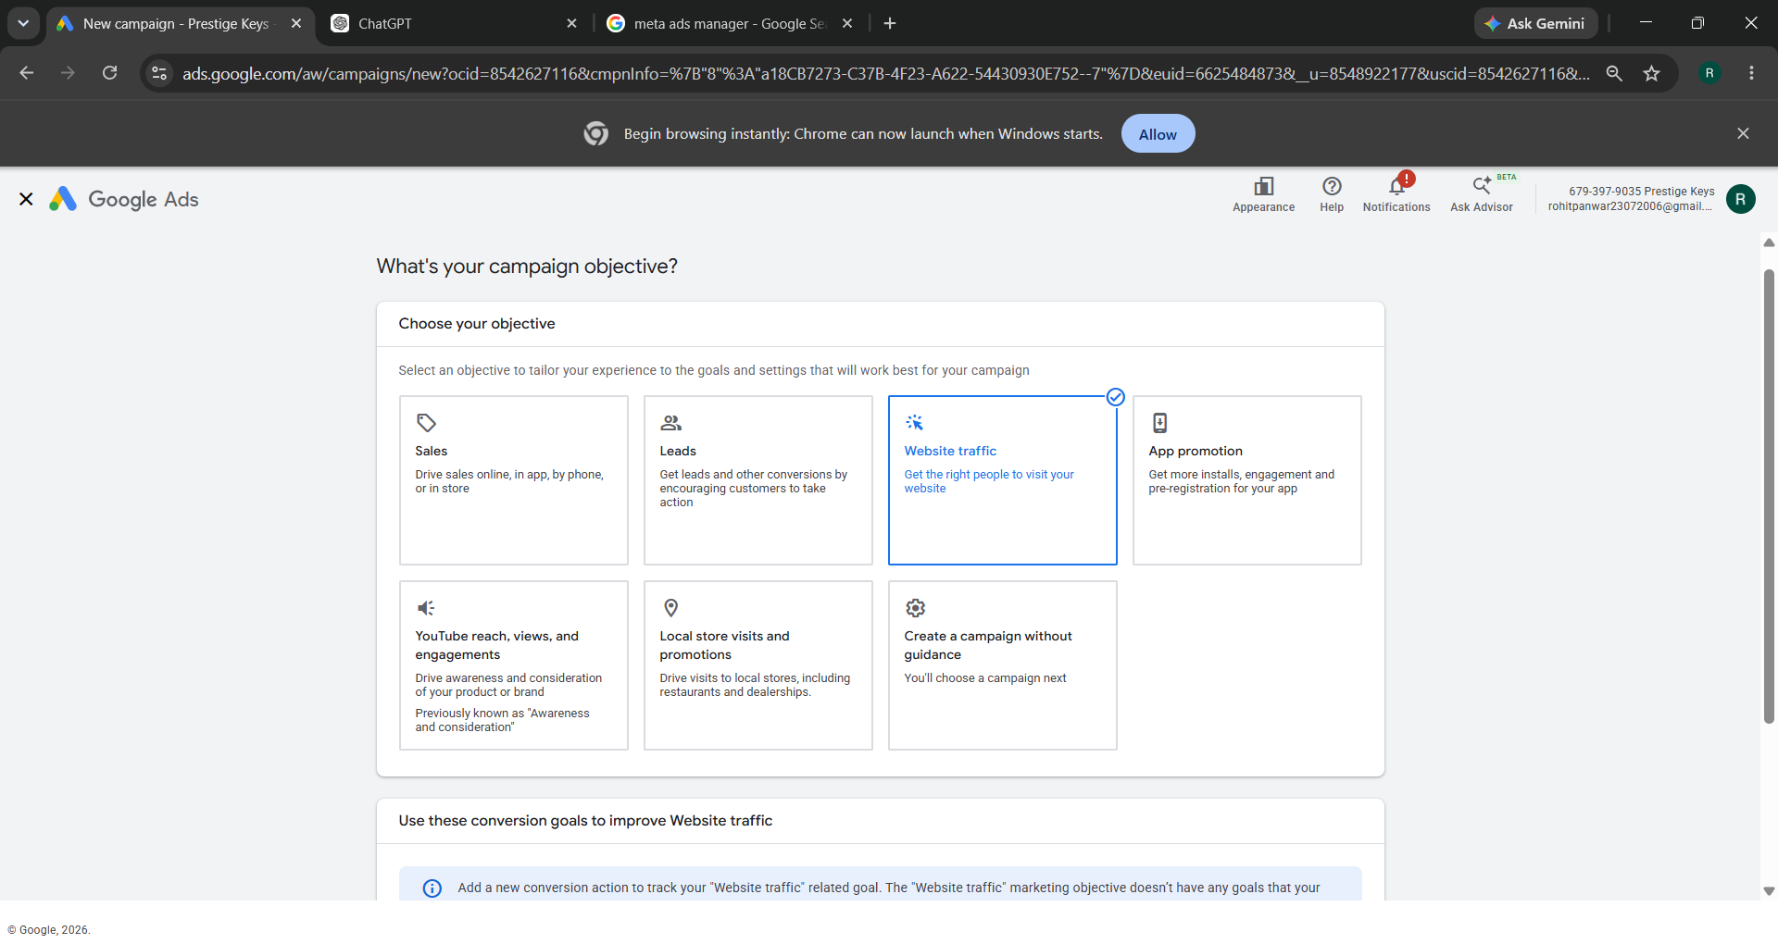
Campaign Objectives

Slide 11
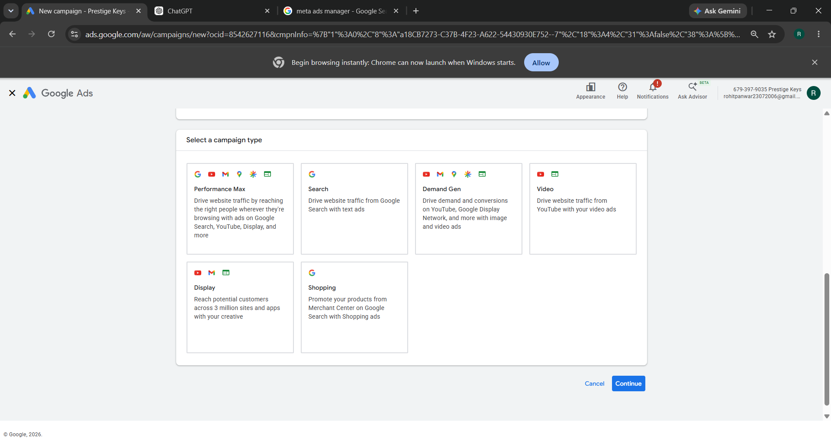
Campaign Types

Slide 12
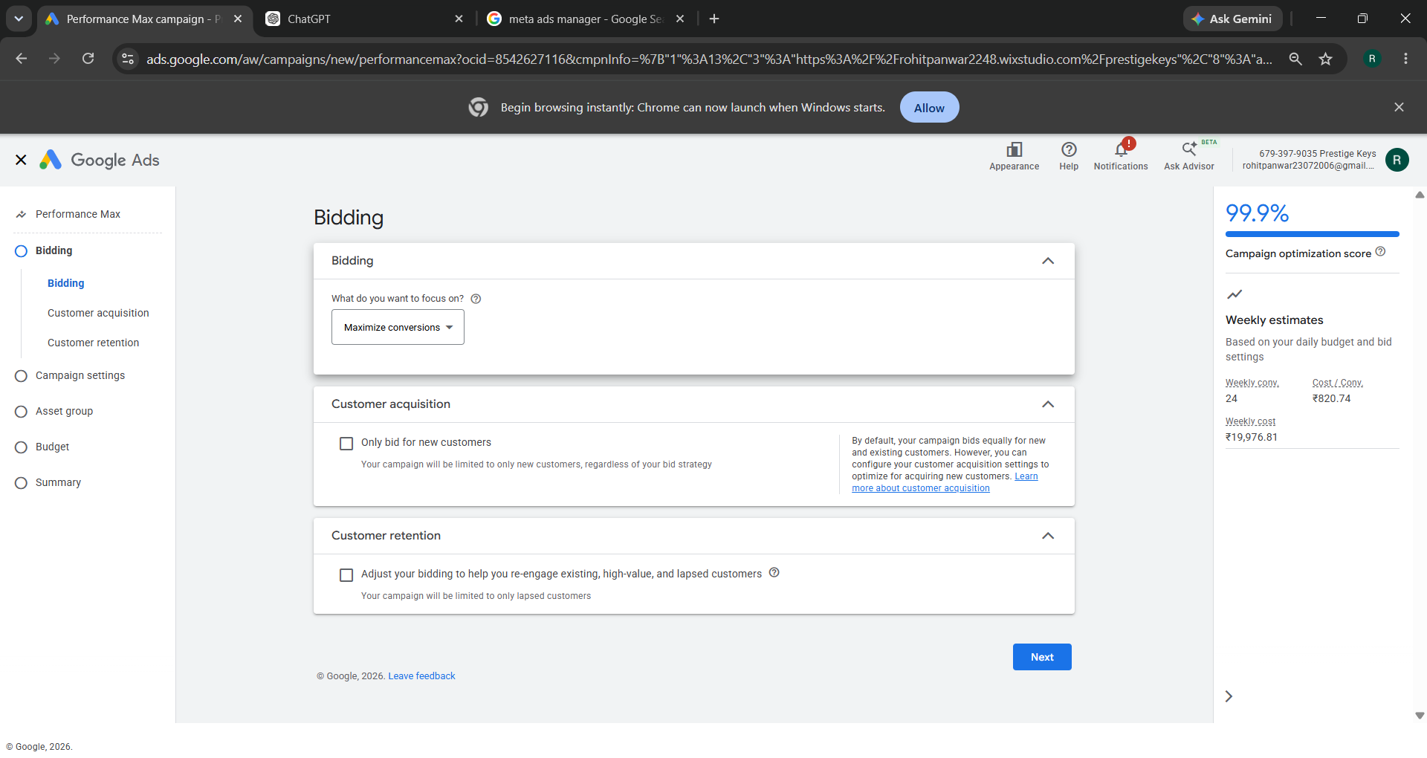
Bidding

Slide 13
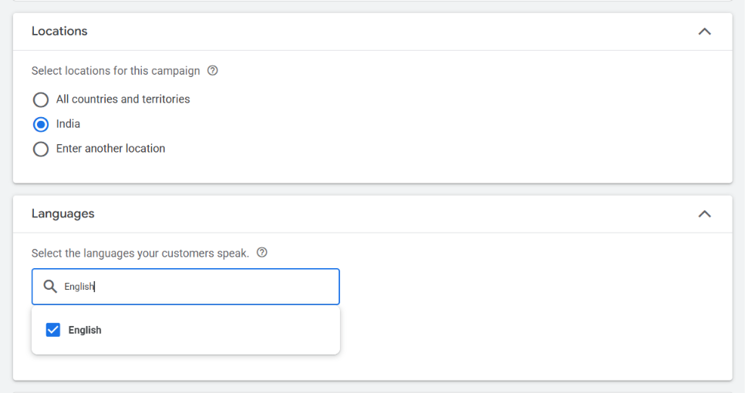
Campaign Settings : Location and Language

Slide 14
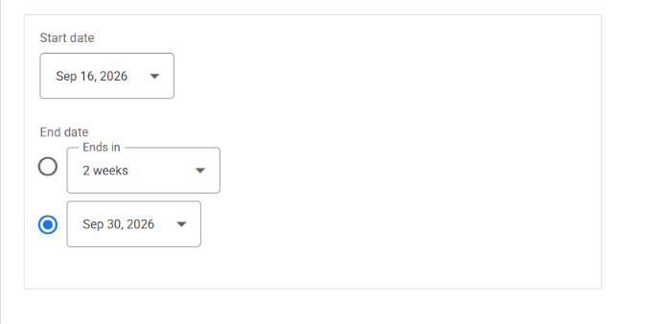
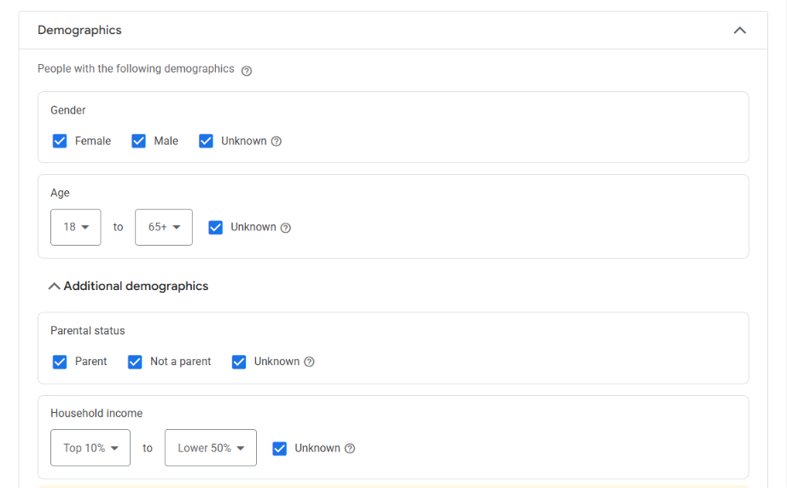
Campaign Settings

Slide 15
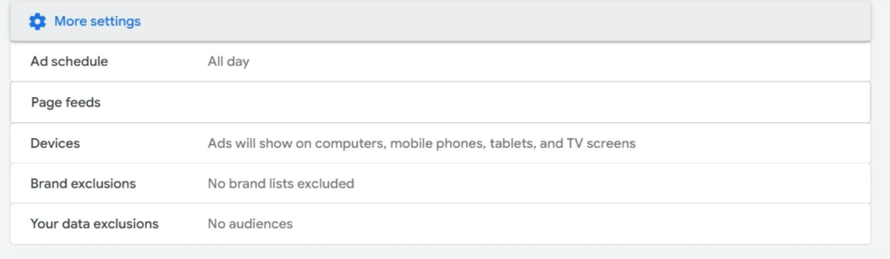
Campaign Settings

Slide 16
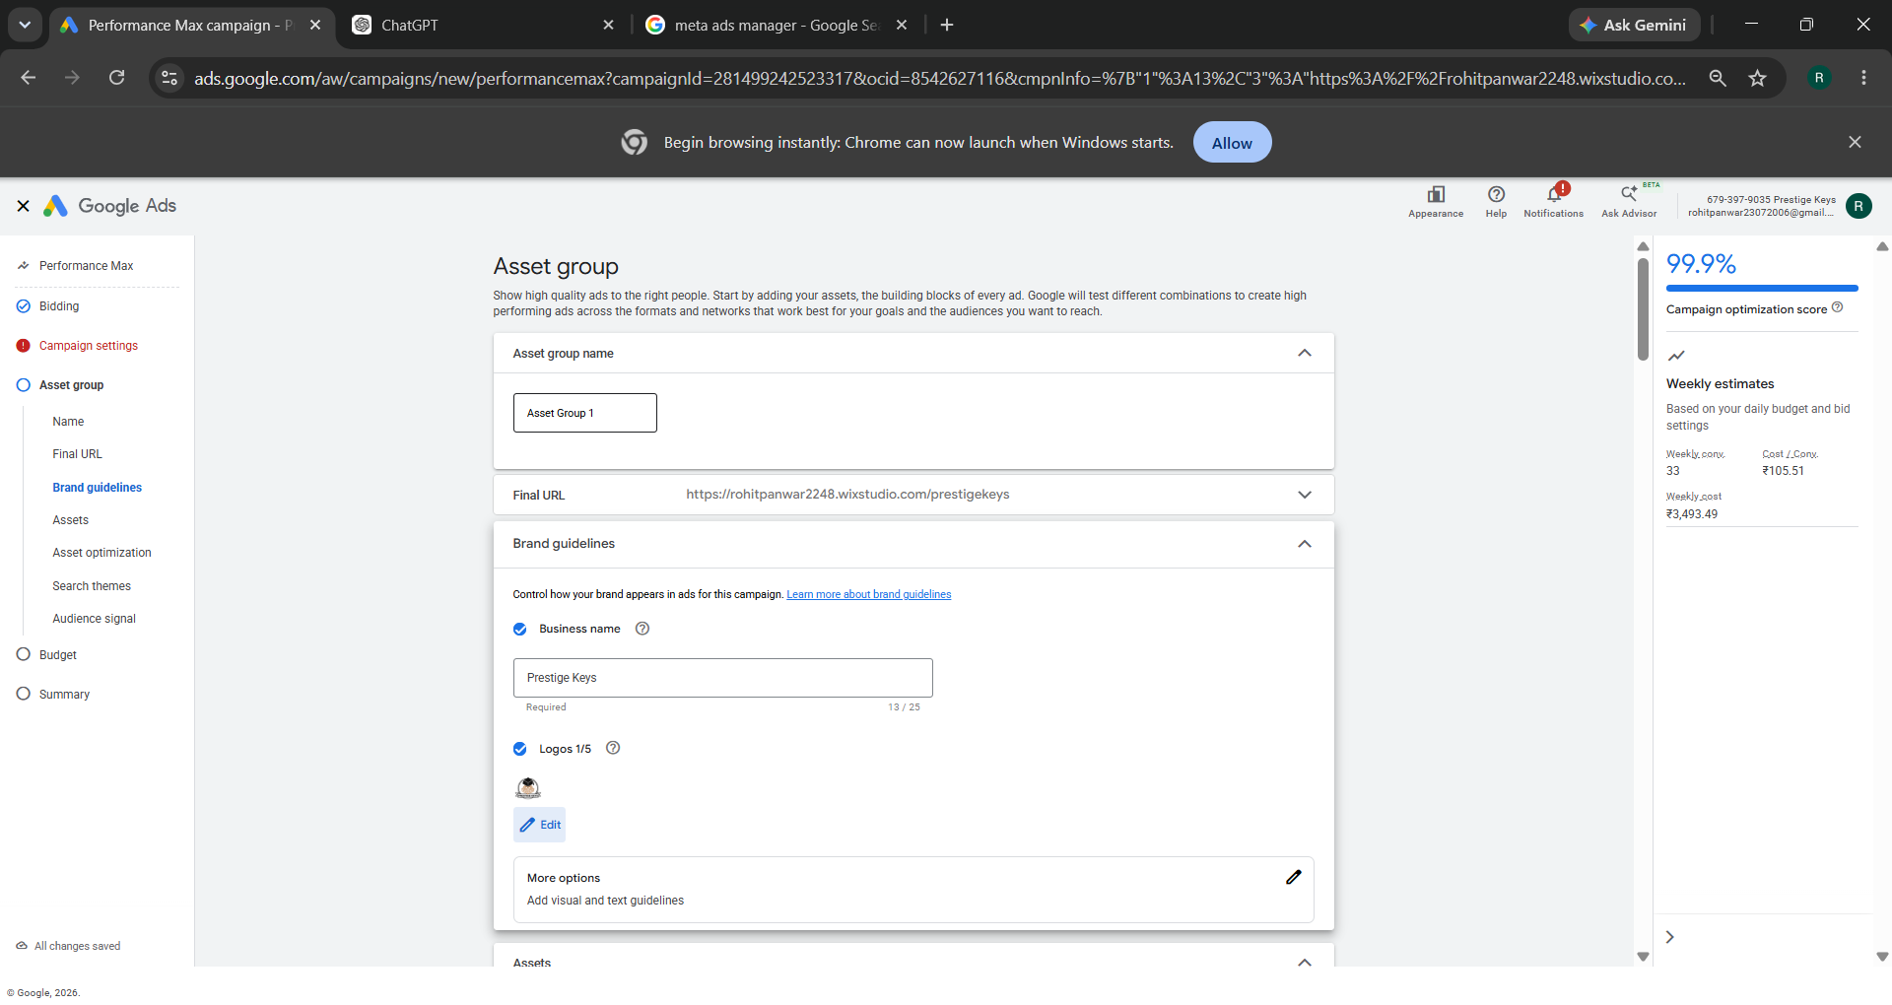
Campaign Settings : Asset Group

Slide 17
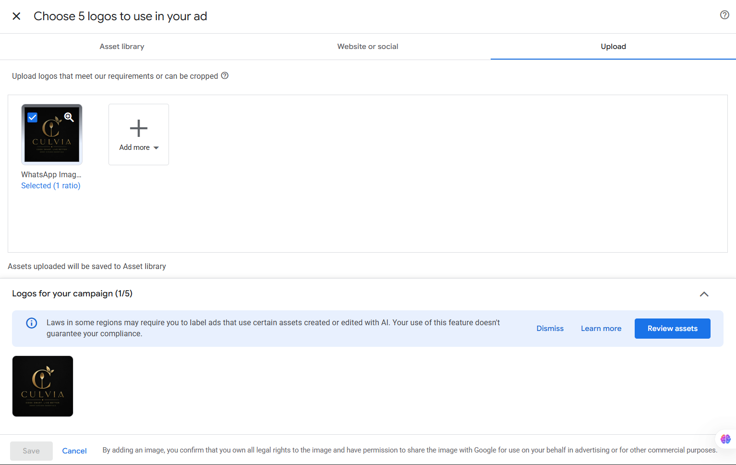

Campaign Settings : Asset Group

Slide 18
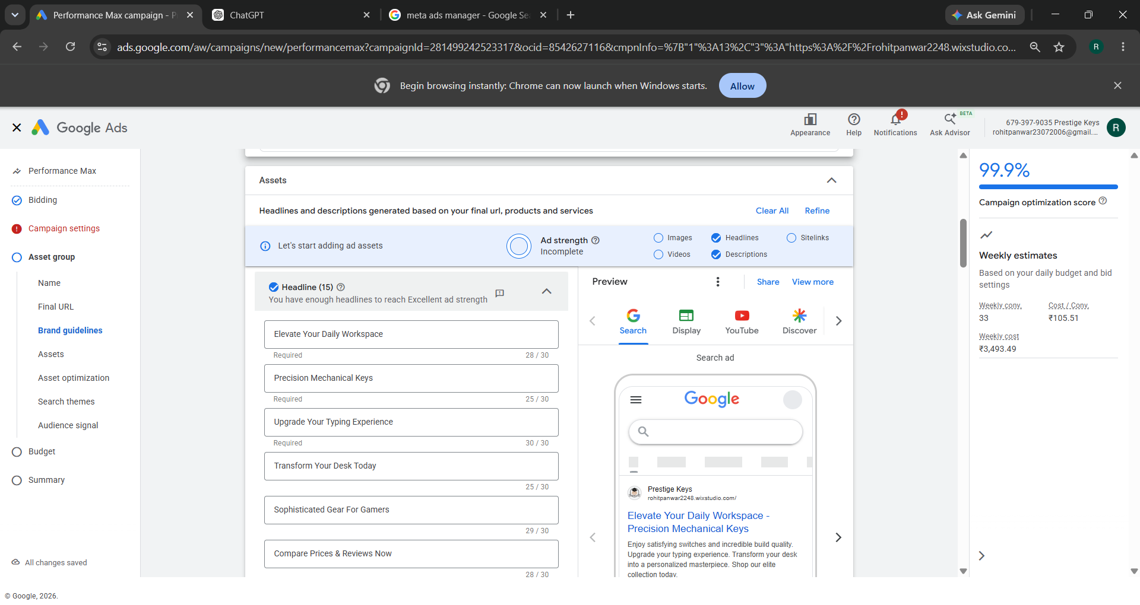
Campaign Settings : Asset Group

Slide 19
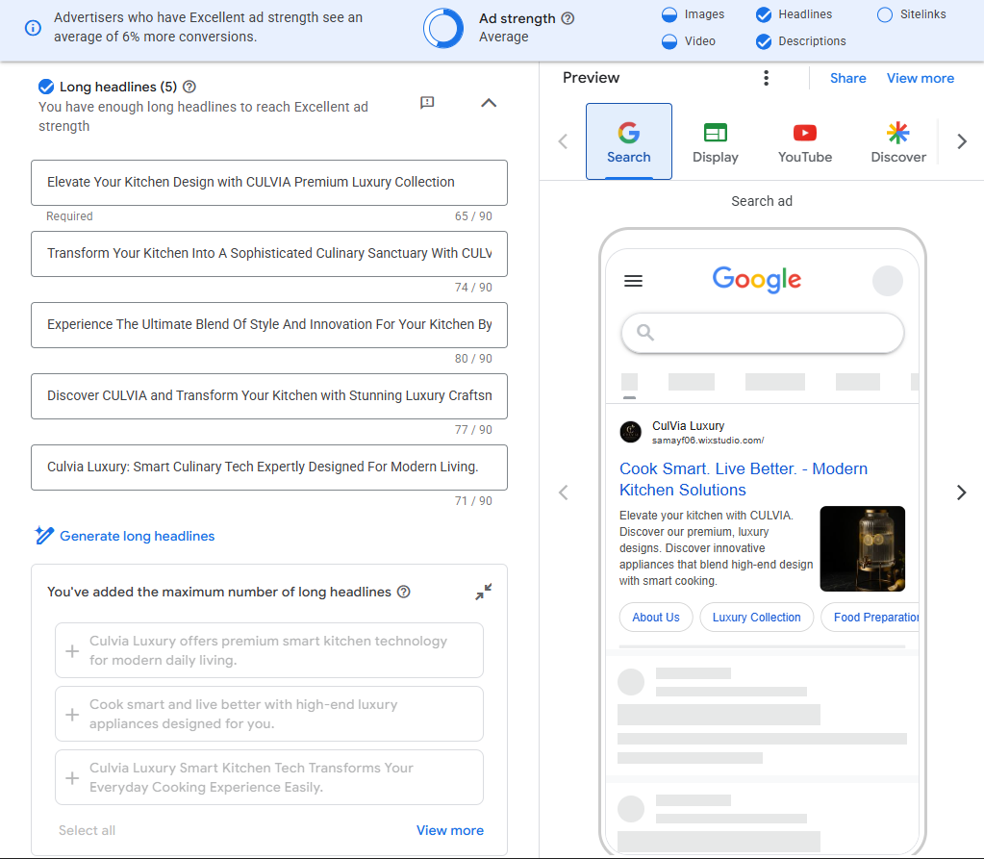
Campaign Settings : Asset Group

Slide 20
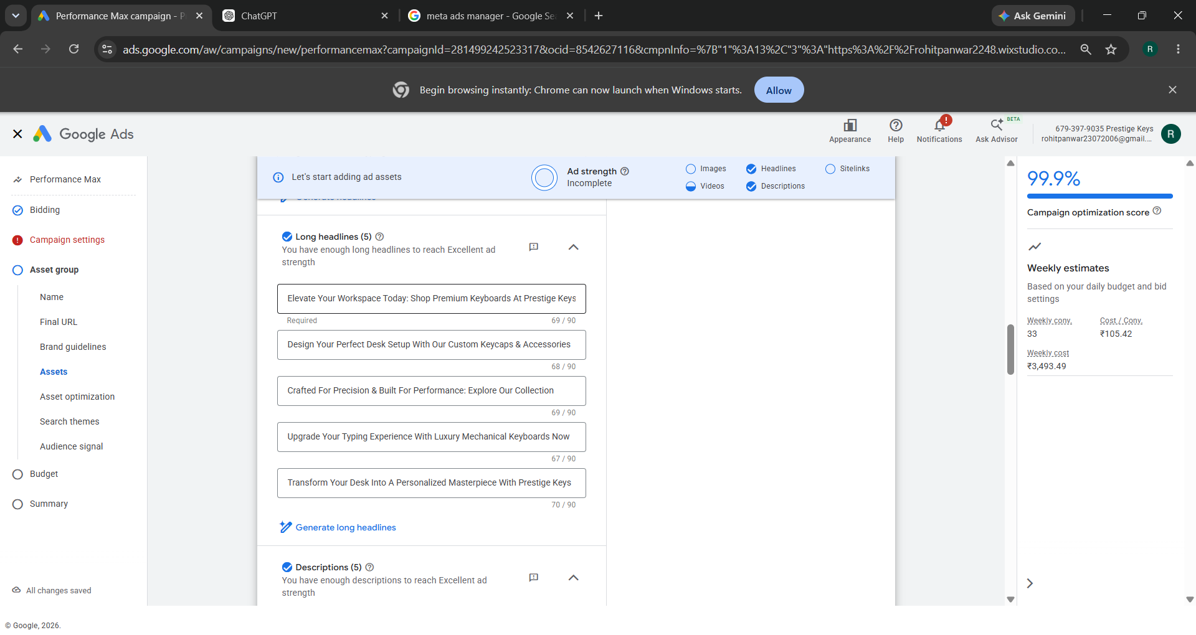
Campaign Settings : Asset Group

Slide 21
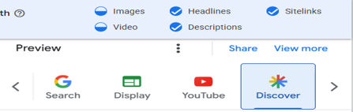
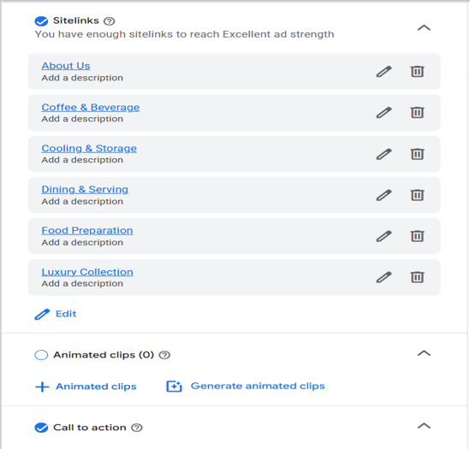
Campaign Settings : Review Asset

Slide 22
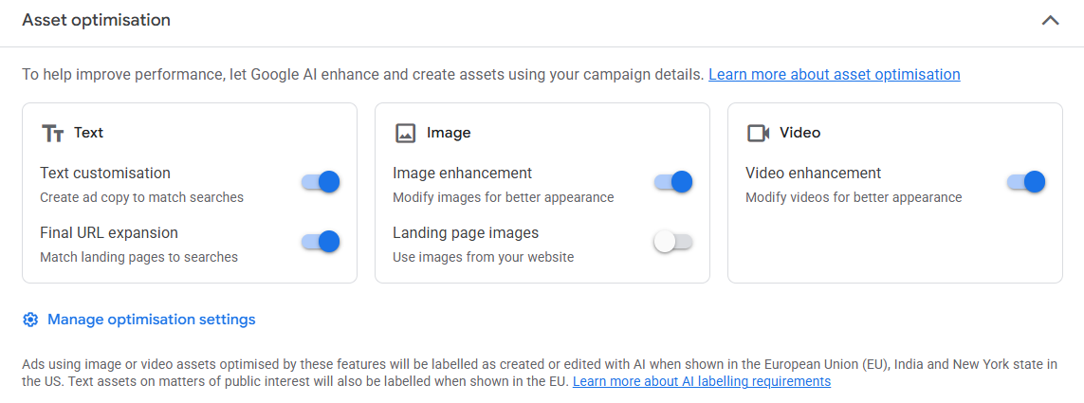
Campaign Settings : Asset Optimization

Slide 23
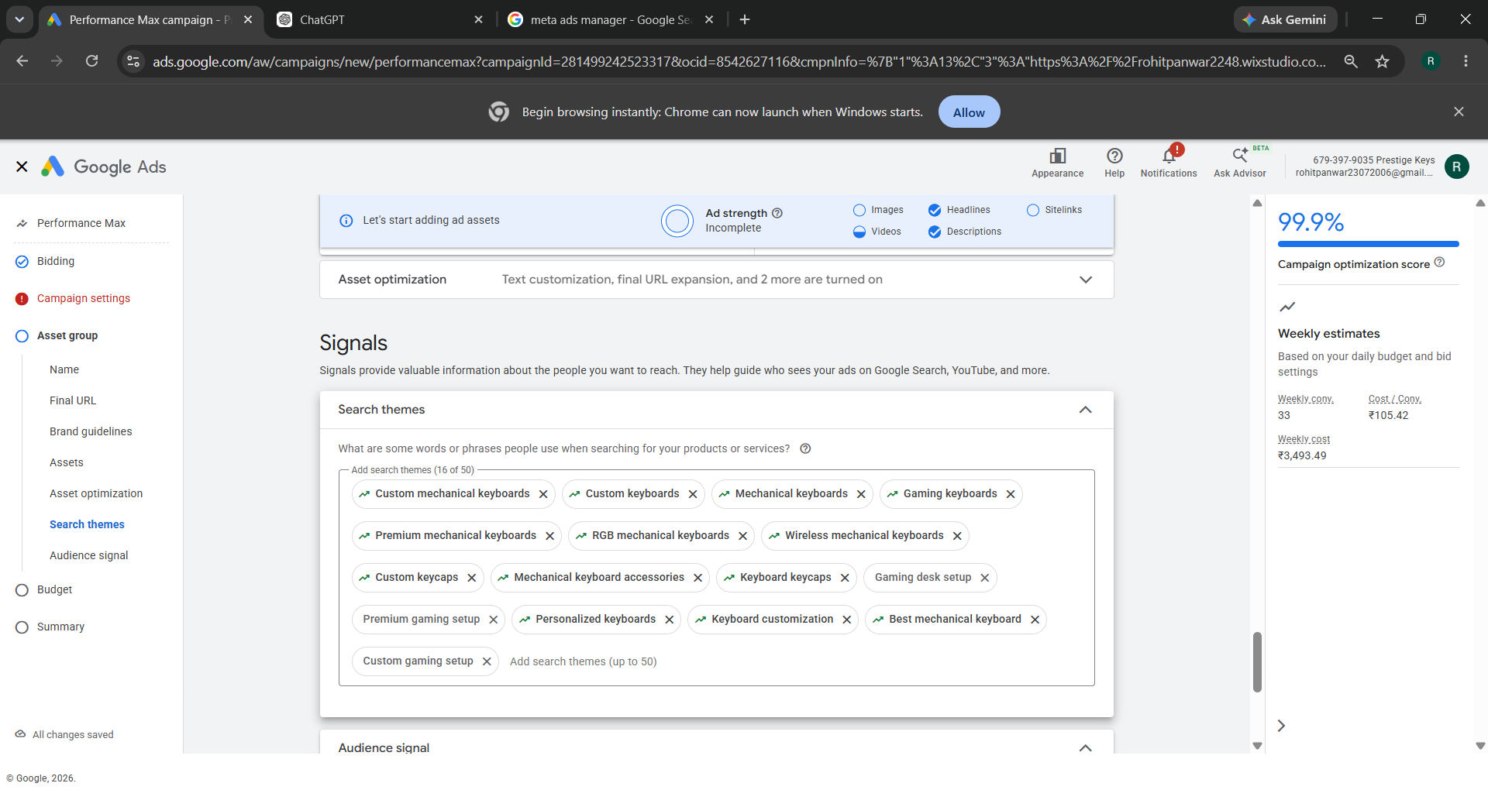
Campaign Settings : Signals

Slide 24
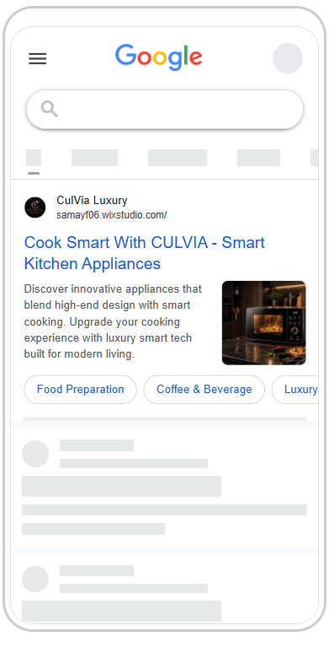
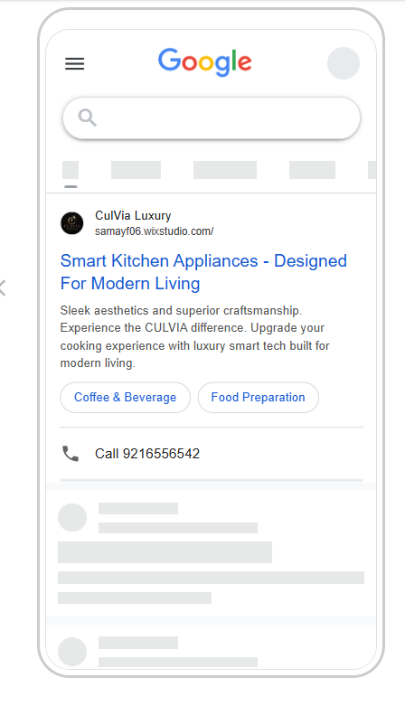

Ads Previews

Slide 25
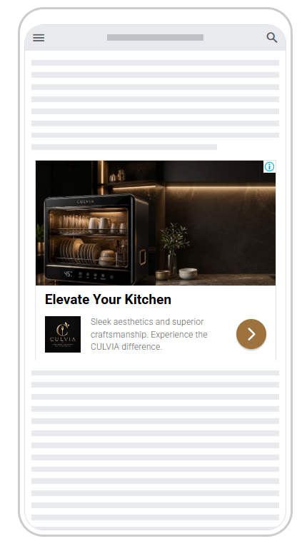
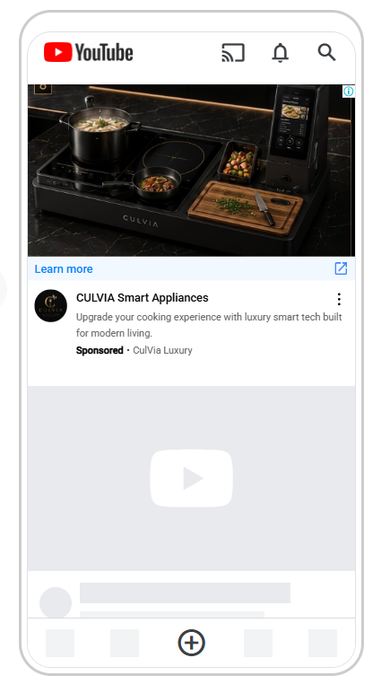
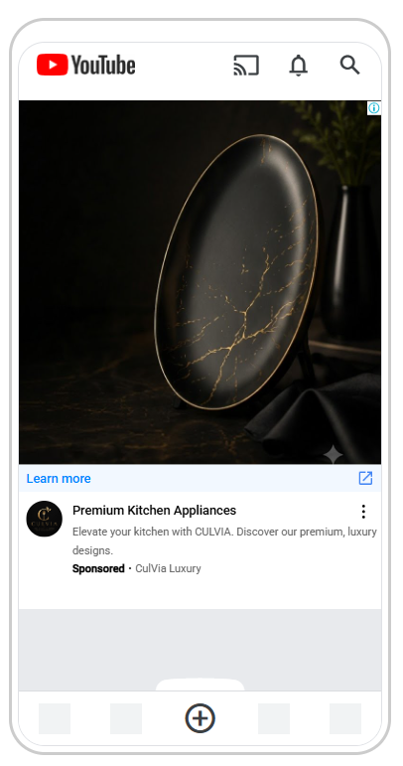
Ads Previews

Slide 26
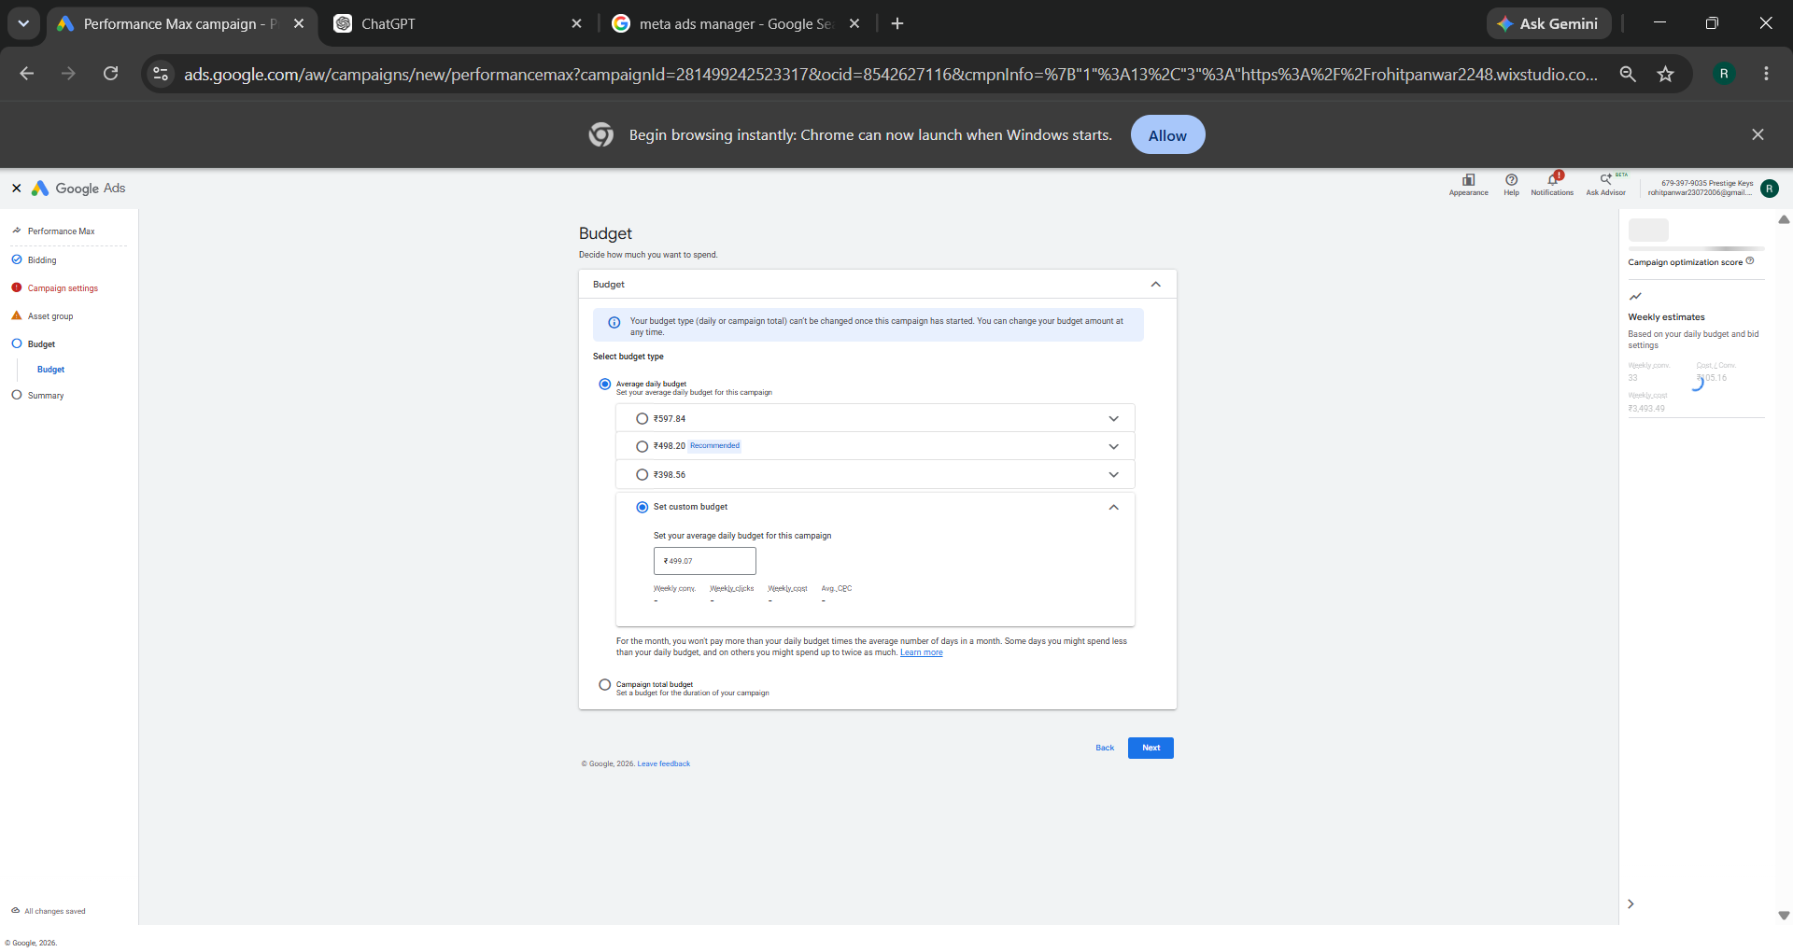
Google Ads Budget

Slide 27
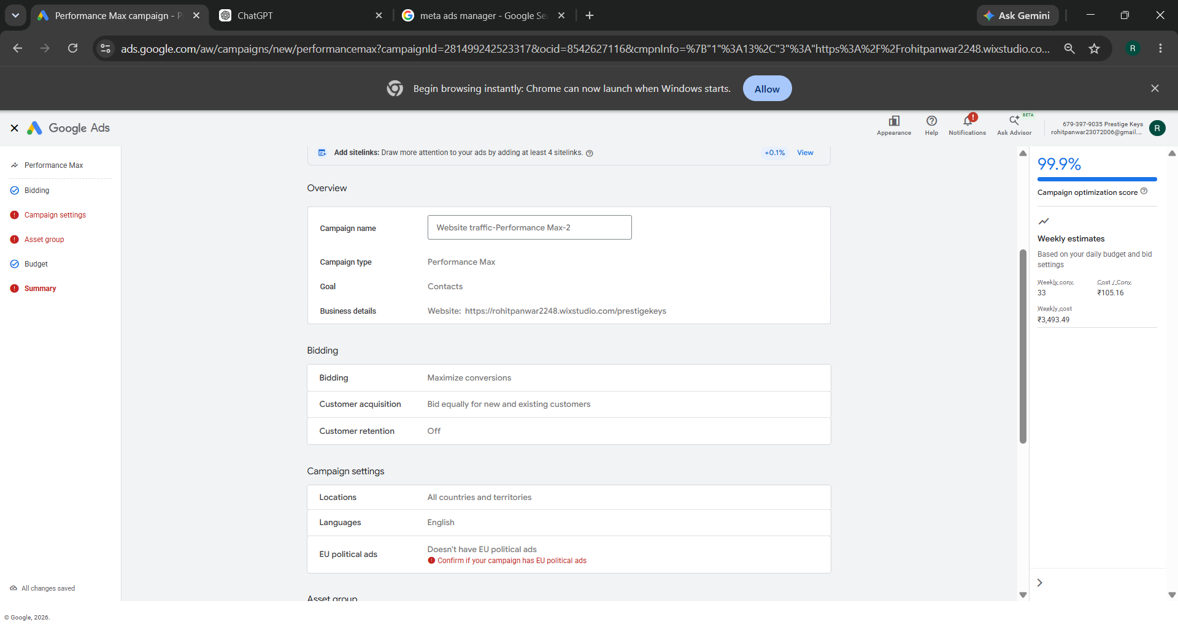
Google Ads Campaign Review

Slide 28
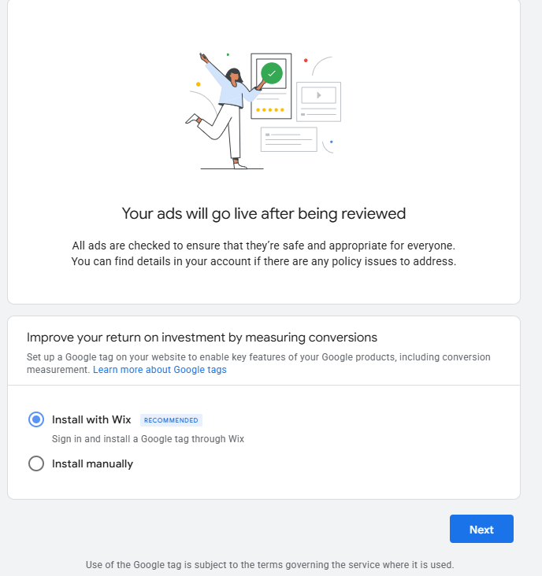
Google Ads Campaign Publish

Slide 29
Campaign Dashboard

Slide 30


